Slide 1
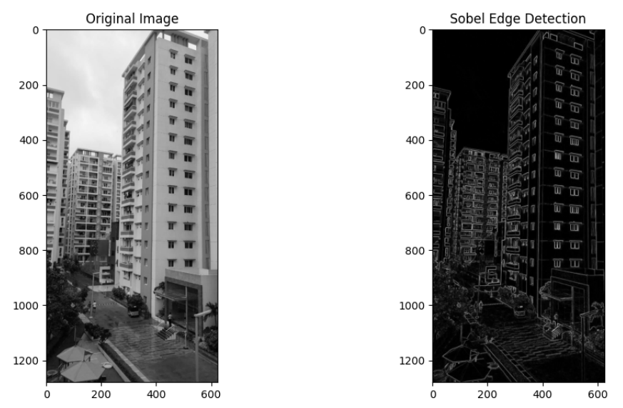
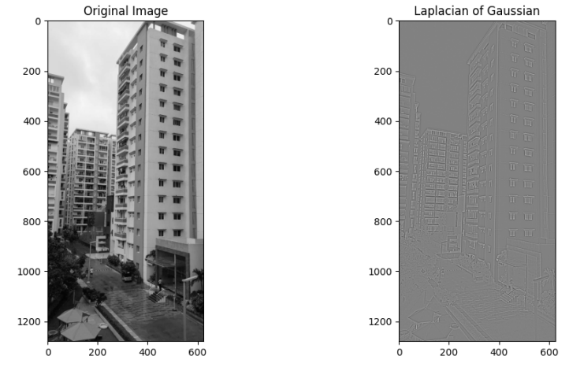
CV ASSIGNMENT 1 Faculty : Dr Tilottama Goswami
Section : A
Group Number : 3
Roll Numbers : 1602-20-737-040, 041
Names : Shreya Chepuri, Shreya Talveda
Image Processing Task : Edge Detection
Algorithms Used : Sobel, Laplacian of Gaussian
Input and Output Images :
Github link : https://github.com/Shreyareddy2803/CV-A1

